Slide 1
QlikSense Training
I&D India – QlikSense CoE

Slide 2
Session 03

Slide 3
Session Agenda
Foundations of Building Visualizations
Understanding Dimensions and Measures
Sorting Items in Visualizations
Limit Dimensions Displayed
Chart Expressions Overview
Control Visualization Calculation
Working with Variables
Color in Visualizations
Formatting in Visualization
Formatting Numbers in Visualizations
Working with Dates
Nested Aggregations
Configure Reference Lines -
Correlated Measures
Calculating Quartiles or Percentiles
Set analysis and set expressions
Understanding Extensions
Introduction to Widgets

Slide 4
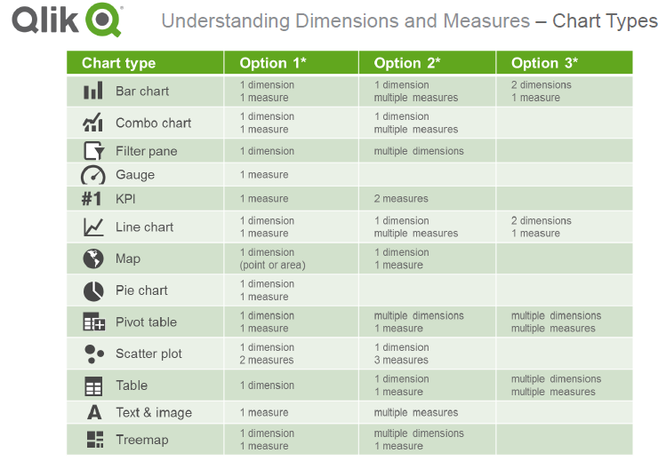
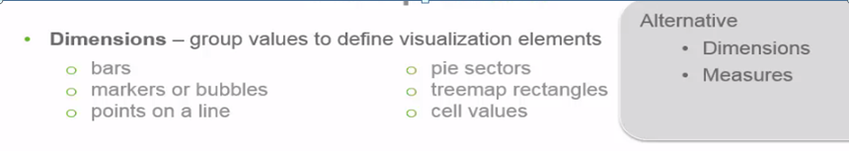
Understanding Dimensions
Dimensions:
Dimensions determine how the data in a visualization is grouped.
Example:
Total sales per country or number of products per supplier. You typically find a dimension as the slices in a pie chart or on the x-axis of a bar chart with vertical bars.
Dimensions are created from fields in the data model tables.

Slide 5
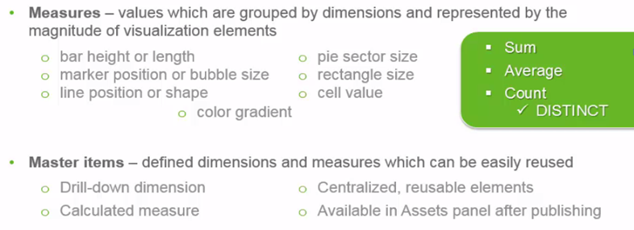
Understanding Measures
Measures:
Measures are calculations used in visualizations, typically represented on the y-axis of a bar chart or a column in a table. Measures are created from an expression composed of aggregation functions, such as Sum or Max, combined with one or several fields.
A measure must have a name, and may also be supplied with descriptive data such as description and tags.

Slide 6
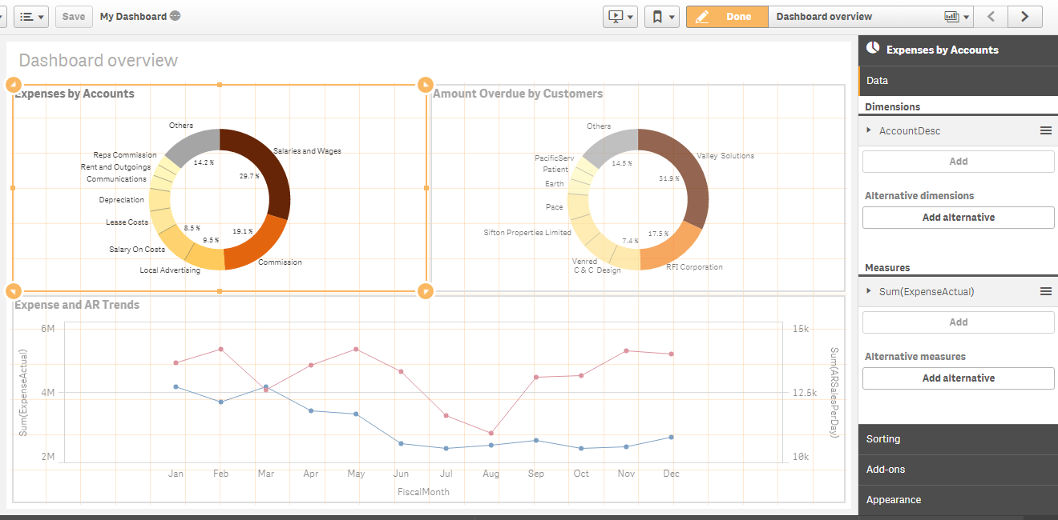
Understanding Dimensions and Measures
Example of Dimensions and Measures in Chart
Measure expression:Sum(ExpenseActual)
Dimension Expression: AccountDesc

Slide 7
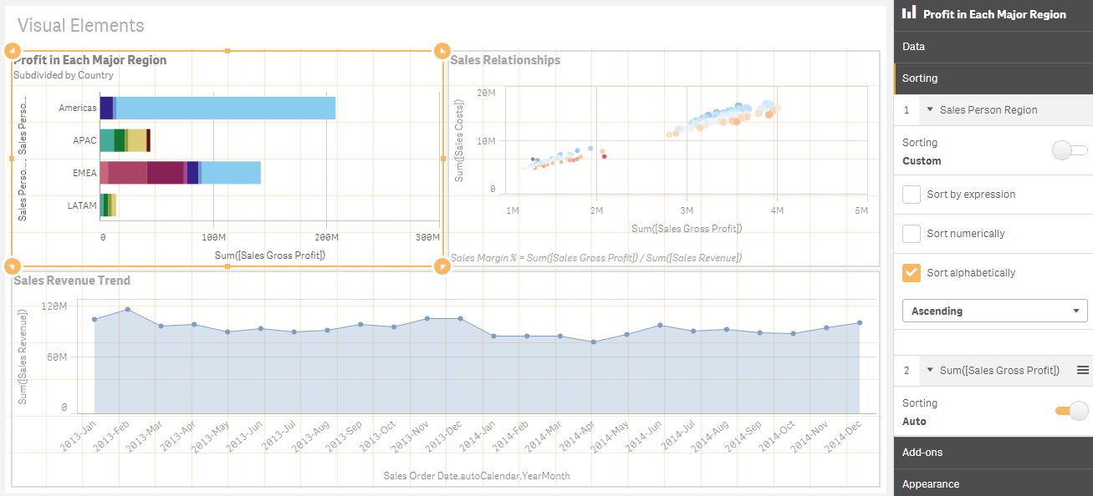

Sorting Items in Visualizations
Sorting
Drag the dimension and measure to set the sorting priority order. The numbers show the order.
The dimension and measure can be sorted internally. Click the dimension or measure name to open the settings and click the sorting button to switch to Custom sorting. The following table shows the sorting priority order and sorting options. The sorting is either Ascending or Descending.
Sort Options:
Auto :It will display the default order
Custom Sort Options:
Sort by expression: Enter an expression to sort by. Only available for dimensions.
Example:- Sum(Measure)

Slide 8
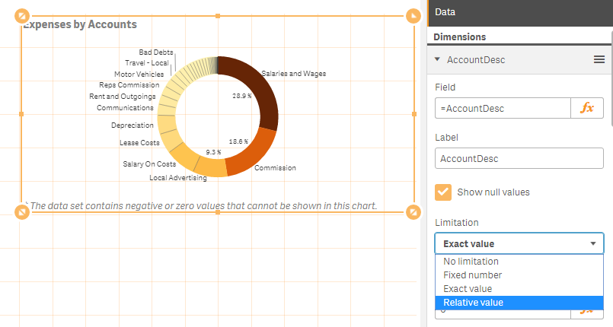
Limit Dimensions Displayed
Limits the number of displayed values. When you set a limitation, the only dimensions displayed are those where the measure value meets the limitation criterion.
No limitation: The default value.
Fixed number: Select to display the top or bottom values. Set the number of values. You can also use an expression to set the number. Click 3 to open the expression editor.
Exact value: Use the operators and set the exact limit value. You can also use an expression to set the number. Click 3 to open the expression editor.
Relative value: Use the operators and set the relative limit value in percent. You can also use an expression to set the number. Click to open the expression editor.
Calculated on measure: <measure>: Shown when you make a limitation to the number of displayed dimension values. The dimensions whose measure value meet the criterion are displayed.

Slide 9
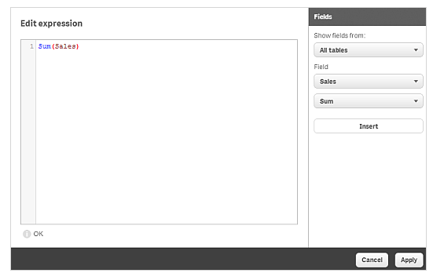
Chart Expressions Overview
Visualizations in Qlik Sense are built from charts, which in turn, are built from dimensions and measures, depending on the type of chart. Visualizations can have titles, subtitles, footnotes, and other elements to help convey information.
Expressions can be used in a visualization wherever the symbol is seen in the properties panel while editing a visualization. The 3 symbol indicates an expression field.
By clicking , you enter the expression editor, which is designed to help you build and edit expressions(i.e. see in diagram)

Slide 10
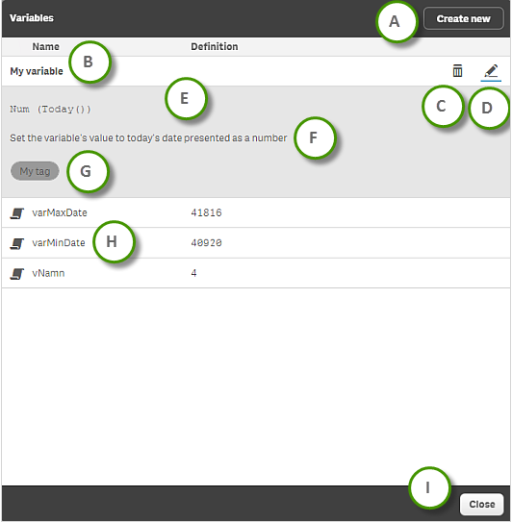
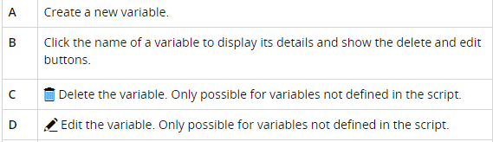
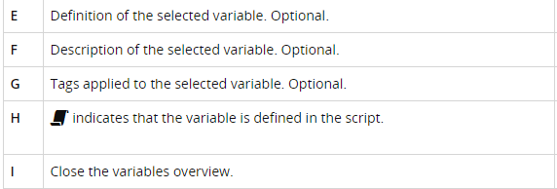
Working with Variables
What is Variable ?
A variable in Qlik Sense is a container storing a static value or a calculation, for example a numeric or alphanumeric value. When you use the variable in the app, any change made to the variable is applied everywhere the variable is used. Variables can be defined by SET and LET statements.
Variables are defined using the variables overview or in the script using the data load editor.
Example: LET vResult1 = 1 + 1; Result : 2
SET vResult2 = 1 + 1; Result : 1+1
Notes:
You open the Variables overview by clicking Ò in the edit bar when editing a sheet.
The variables overview lists all the variables that you can use in the expressions that are used for making calculations based on the data in the app. When used, the variable is substituted by its value. Variables are case sensitive.

Slide 11
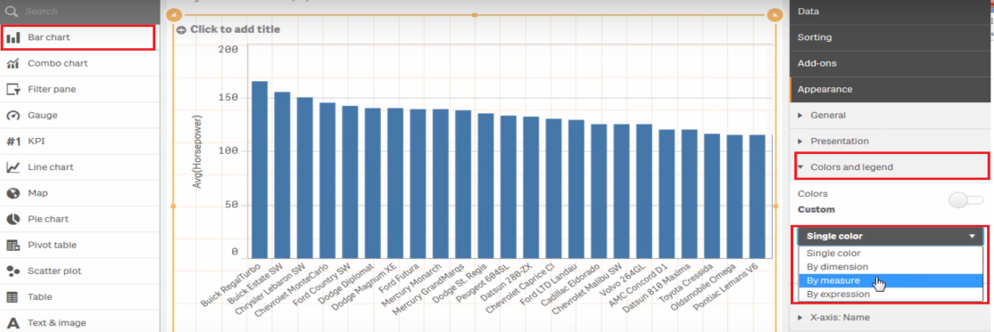
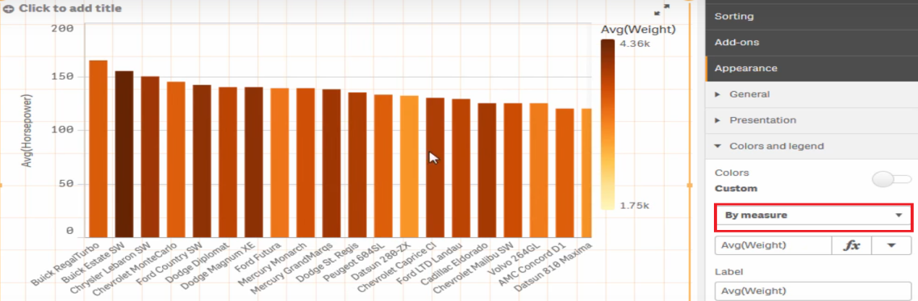
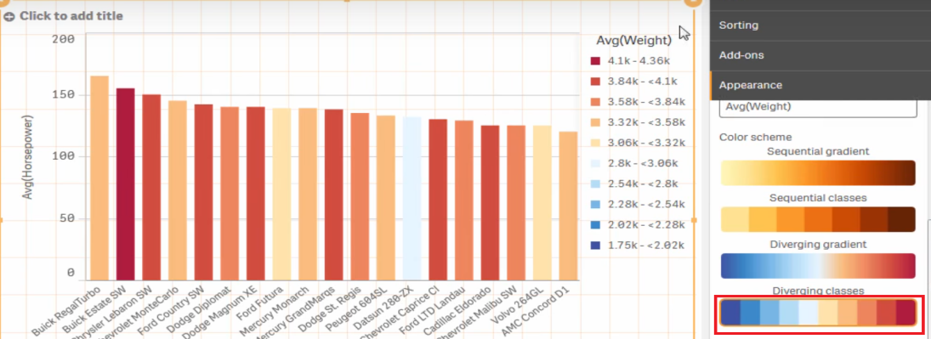
Color in Visualizations
You can change the color of a visualization using the chart properties panel. You can also drag and drop any field, dimension or measure from the asset panel onto a visualization to change the color
Example :

Slide 12
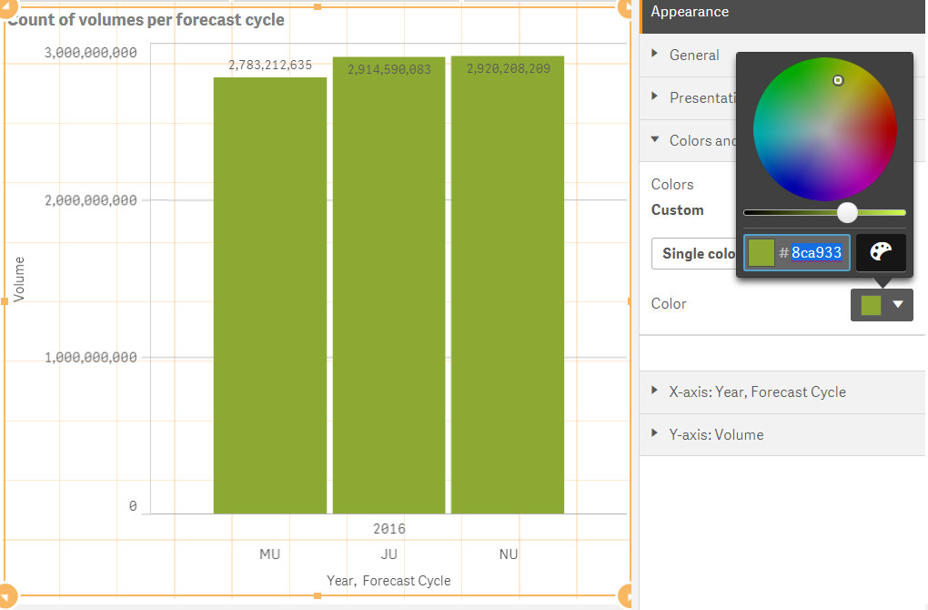
Spotlight: A Custom Categorical Color Solution
We can choose and Single color in Custom Color. That way it will put a single color for each of the Bar in the Graph.
For each color in QlikSense there is a corresponding Hex Code we can put.
Example:
Hex Code:- #8ca933
RGB(140, 169, 51)

Slide 13
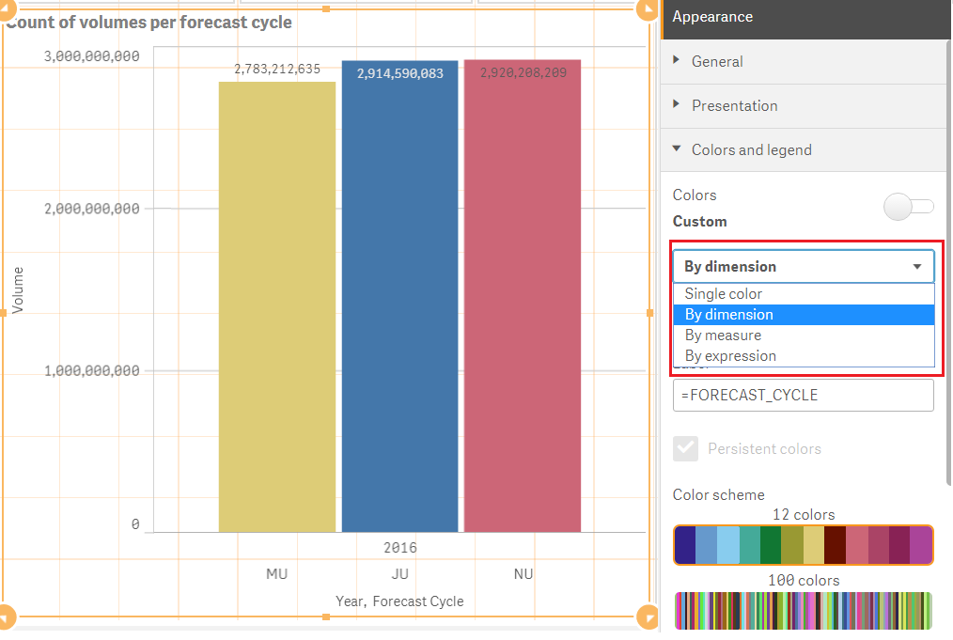
Spotlight: A Custom Categorical Color Solution
We can also choose Custom color set a. By Dimension
b. By Measure
c. By expression Accordingly the color will also vary. If we set By Dimension then based on number of dimension it will set the colors. And through out the application for a particular dimension value the same color will persist.

Slide 14
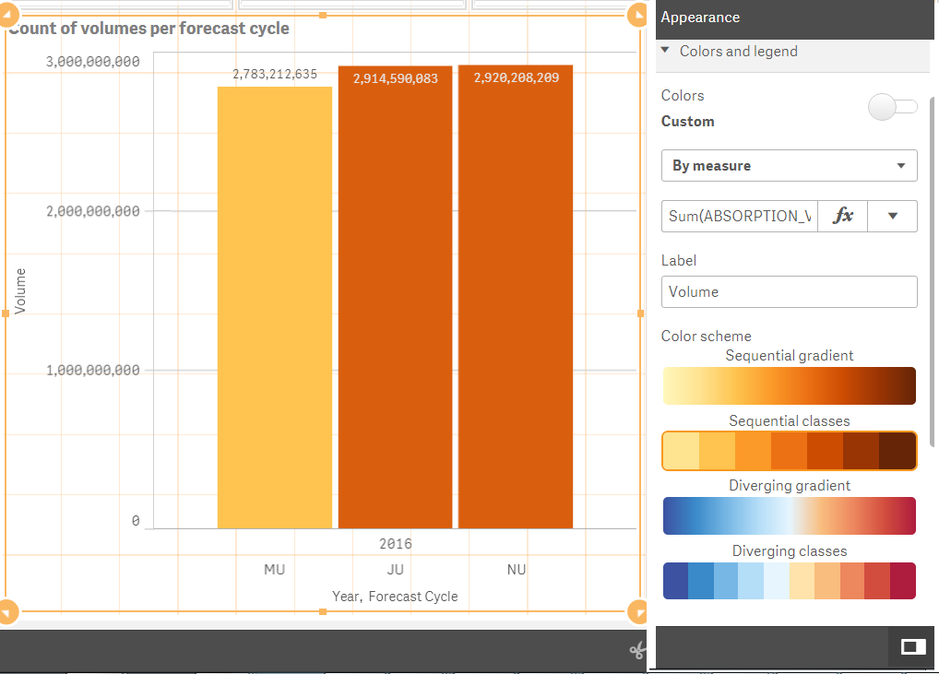
A Custom Categorical Color Solution (Contd..)
If we put the Custom color By Measure, then based on the Measure that we took in the expression the color will vary. For example:- if we put Sum(Absorption Value) Then for JU and NU as the value is close so it kept same color for both of the bars where as for MU it kept some other color. We can also choose separate color scheme like:-
1. Sequential gradient
2. Sequential classes
3. Diverging gradient 4. Diverging classes
If we put the Custom color By Expression, then based on the explicit Expression that we took in the Fx , the color will vary.

Slide 15
Formatting in Visualization
In formatting functions it is possible to set the format for numbers and dates by using a format code.
This topic describes the conventions used to format a number, date, time or time stamp.
These conventions apply both to script and chart functions.
Below are the types of number formats.
Number formats
Special number formats
Dates
Times
Time stamps

Slide 16
Format Numbers
Number Formats:
To denote a specific number of digits, use the symbol "0" for each digit.
To denote a possible digit, use the symbol "#". If the format contains only # symbols to the left of the decimal point, numbers less than 1 begin with a decimal point.
Example:
# ##0 | describes the number as an integer with a thousands separator.
###0 | describes the number as an integer without a thousands separator.
0000 | describes the number as an integer with at least four digits. For example, the number 123 will be shown as 0123.
0.000 | describes the number with three decimals.
0.0## | describes the number with at least 1 decimal and at most three decimals.

Slide 17
Format Numbers (Contd..)
Special Number formats:
Qlik Sense can interpret and format numbers in any radix between 2 and 36 including binary, octal and hexadecimal. It can also handle roman formats. Below are the various formats
Binary format
Octal format
Hexadecimal format
Decimal format
Roman format
Example:
num(199, '(bin)') | returns | 11000111
num(199, '(oct)') | returns | 307
num(199, '(hex)') | returns | c7
num(199, '(HEX)' ) | returns | C7
num(199, '(r02)' ) | returns | 11000111
num(199, '(r16)') | returns | c7
num(199, '(R16)' ) | returns | C7
num(199, '(R36)') | returns | 5J
num(199, '(rom)') | returns | cxcix
num(199, '(ROM)' ) | returns | CXCIX

Slide 18
Format Dates
Dates:
You can use the following symbols to format a date. Arbitrary separators can be used.
D | To describe the day, use the symbol "D" for each digit.
M | To describe the month number, use the symbol "M". Use "M" or "MM" for one or two digits. "MMM" denotes short month name
Y | To describe the year, use the symbol "Y" for each digit.
W | To describe the weekday, use the symbol "W". "W" will return the number of the day (for example 0 for Monday) as a single digit. "WW" will return the number with two digits (e.g. 02 for Wednesday). "WWW" will show the short version of the weekday name (for example Mon) as defined by the operating system or by the override system variable DayNames in the script. "WWWW" will show the long version of the weekday name (for example Monday) as defined by the operating system or by the override system variable LongDayNames in the script.

Slide 19
Format Dates (Contd..)
Examples: (with 31st March 2013 as example date)
YY-MM-DD | describes the date as 13-03-31.
YYYY-MM-DD | describes the date as 2013-03-31.
YYYY-MMM-DD | describes the date as 2013-Mar-31.
DD MMMM YYYY | describes the date as 31 March 2013.
M/D/YY | describes the date as 3/31/13.
W YY-MM-DD | describes the date as 6 13-03-31.
WWW YY-MM-DD | describes the date as Sat 13-03-31.
WWWW YY-MM-DD | describes the date as Saturday 13-03-31.

Slide 20
Format Time
Times
You can use the following symbols to format a time. Arbitrary separators can be used.
h | To describe the hours, use the symbol "h" for each digit.
m | To describe the minutes, use the symbol "m" for each digit.
s | To describe the seconds, use the symbol "s" for each digit.
f | To describe the fractions of a second, use the symbol "f" for each digit.
tt | To describe the time in AM/PM format, use the symbol "tt" after the time.
Examples: (with 18.30 as example time):
hh:mm | describes the time as 18:30
hh.mm.ss.ff | describes the time as 18.30.00.00
hh:mm:tt | describes the time as 06:30:pm

Slide 21
Format Time (Contd..)
Time stamps:
The same notation as that of dates and times above is used in time stamps.
Examples: (with 31th March 2013 18.30 as example time stamp):
YY-MM-DD hh:mm | describes the time stamp as 13-03-31 18:30
M/D/Y hh.mm.ss.ffff | describes the time stamp as 3/31/13 18.30.00.0000

Slide 22
Nested Aggregations
Nested aggregations:
You may come across situations where you need to apply an aggregation to the result of another aggregation. This is referred to as nesting aggregations.
As a general rule, it is not allowed to nest aggregations in a Qlik Sense chart expression. Nesting is only allowed if you
Use the TOTAL qualifier in the inner aggregation function.
No more than 100 levels of nesting is allowed.

Slide 23
Nested Aggregations
Nested aggregations with the TOTAL qualifier
Example:
You want to calculate the sum of the field Sales, but only include transactions with an OrderDate equal to the last year.
The last year can be obtained via the aggregation function Max(TOTAL Year(OrderDate)).
The following aggregation would return the desired result:
Sum(If(Year(OrderDate)=Max(TOTAL Year(OrderDate)), Sales))
The inclusion of the TOTAL qualifier is absolutely necessary for this kind of nesting to be accepted by Qlik Sense, but then again also necessary for the desired comparison. This type of nesting need is quite common and is a good practice.
Nested aggregations with the aggregation function
Nesting with TOTAL is not always enough.
For more generic nesting, you will have to use the advanced
aggregation function in combination with calculated dimensions.

Slide 24
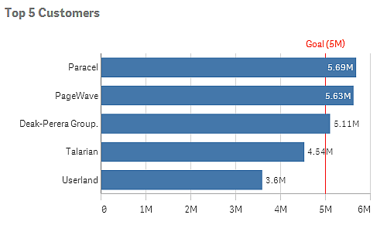
Configure Reference Lines
Reference lines
A reference line is a line intersecting the chart area from a given point on the measure axis. You can use a reference line to indicate a certain level of chart data. The reference line is only drawn if it falls within the current range of the measure axis. You can have several reference lines in the same chart.
Reference lines are available in bar charts, gauges, line charts, and scatter plots.
Bar chart with a reference line at 5M
Reference line expression
You can either set the reference line expression to an absolute numeric value, or enter an arbitrary numeric expression.

Slide 25
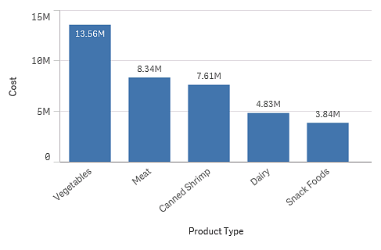
Correlated Measures
Measures are calculations used in visualizations, typically represented on the y-axis of a bar or line chart or a column in a table. Measures are created from an expression composed of aggregation functions, such as Sum or Max, combined with one or several fields.
A measure must have a name, and may also be supplied with descriptive data such as description and tags.

Slide 26
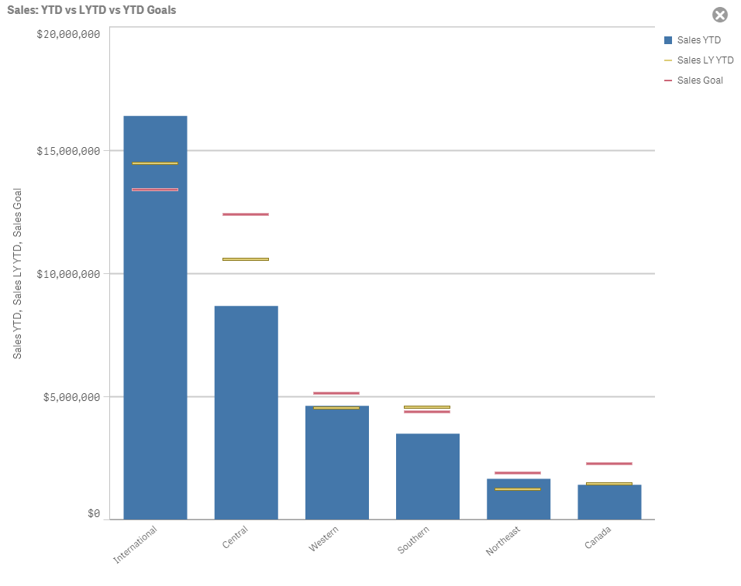
Why Correlated Measures
Correlated measures in required to plot the proper metrics in a chart.
When more than one metrics used the correlation between different metrics should be there.
In the example Sales YTD is plotted with LY YTD and Sales Goal.

Slide 27
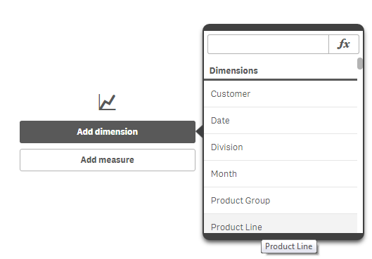
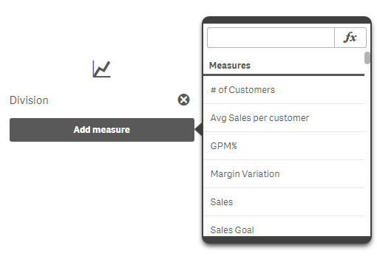
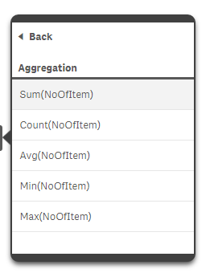
How to Create Correlated Measures
Drag a proper chart for analysis.
Select Dimensions, more than one dimensions can be taken. To toggle between dimensions select alternate dimension.
Select measure with proper aggregation function.

Slide 28
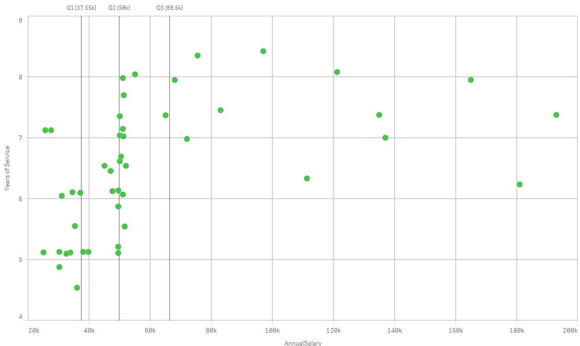
Calculating Quartiles or Percentiles
For plotting Quartile data against X axis where ‘AnnualSalary’ field is being used, Y axis is having ‘Yearof Service’ field.
“fractile(AnnualSalary,x)” this expression can be used, where X can be (0.25,0.5,0.75 forQ1,Q2,Q3 respectively.
Q1,Q2,Q3 can be added as reference line under data setting(Add-ons) tab.

Slide 29
Set analysis and set expressions
Set analysis offers a way of defining a set (or group) of data values that is different from the normal set defined by the current selections.
Set analysis is also powerful when making different sorts of comparisons, such as what are the best-selling products compared with poorly-selling products, or this year against last year.
Defining a set of field values is referred to as defining a set expression, whereas using set expressions to analyze data is referred to as set analysis. Consequently, the rest of this section focuses on the set expression and its components.
Here is a set analysis example: sum( {$<Year={2009}>} Sales ), in which {$<Year={2009}>} is a set expression.
There are two general syntax rules for a set expression:
A set expression must be used in an aggregation function. In this example, the aggregation function is sum(Sales).
A set expression must be enclosed by braces, {}. In the example, the set expression is: {$<Year={2009}>}.

Slide 30
Set analysis and set expressions
Syntax is broken into 3 categories:
Identifiers Operators Modifiers
Identifiers :
0 - Represents empty set
1 - Represents full set of al the records in the application
$ - Represents the records of current selection
$1 - Represents previous selection
Examples:
Sum({1} Sales) - Returns total sales within the application disregarding selections
Sum({$}Sales) - Returns sales for current selection same as sum(sales)
Sum({$1}Sales) - Returns sales for previous selection
Operators:
+ Union - Returns the set of records that belong to Union Set
- Exclusion - Returns records that belong to the first but not the other set identifiers
* Intersection Returns record that belongs to both of set identifiers
/ Symmetric Difference Returns a set that belongs to either, but not both of set identifiers
Sum({1-$}Sales Returns sales for everything excluding current selections
Sum({$*Bookmark01}Sales) Returns sales for intersection between current selection and Bookmark01
Sum({-($+Bookmark01)}sales) Returns sales excluded by current selection and Book mark01
Modifiers: Conditions
They begin and end with angular brackets

Slide 31
Set expressions
Example 1:
{$<Year={2009}>}
This set expression contains an identifier $, and the modifier <Year={2009>}. This example does not include an operator. The set expression is interpreted as: "All records in the current selection that belong to the year 2009".
Example 2:
Sum({$<Year={2009}>+1<Country={"Sweden"}>} Sales)
This set expression contains the identifiers $ and 1, the operator + and the modifiers <Year={2009}> and <Country={'Sweden'}>.
This set expression is designed to sum the sales for the year 2009 associated with the current selections and add the full set of data associated with the country Sweden across all years.
Set expressions can only be used in expressions for visualizations, not in script expressions.

Slide 32
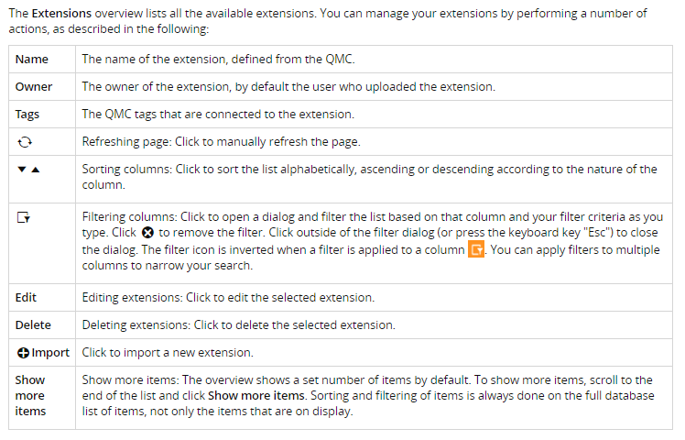
Understanding Extensions
Extensions :
Extensions can be used to visualize data, for example, in an interactive map where you can select different regions.
The Extensions overview lists all the available extensions. The following table presents the available fields and buttons. By default, only some of the fields are displayed. You can use the column selector (') to add fields.

Slide 33
Understanding Extensions
Importing extensions:
By default only the RootAdmin user has the access rights to import extensions. To enable others to import extensions, you need to define security rules for this. Also, by default all Qlik Sense users have access to all extensions that you add. To change this you need to revise the security rule named Extension.
You can add extensions in the following way.
Select Extensions on the QMC start page or from the Start drop-down menu to display the overview.
Click + Import in the action bar.
The Import extension file dialog opens. Select a zip file to import.
Remember to enter the password for the zip file if it is password protected.
Click Open in the file explorer window.
Click Import.

Slide 34
Introduction to Widgets
Widgets:
Widgets are used to customize the behavior and appearance of your sheets and visualizations.
Widgets are simple app objects created using only HTML and CSS/LESS.
You create and edit widgets in the Widget editor and store them in widget libraries, which are then available from the assets panel in your apps. Qlik Sense has a default widget library that contains a set of widgets that are ready to use with little or no customization.
Widgets are best suited for creating simple visualizations, such as KPI objects and tables. Widgets can also be used to add simple functionality to sheets, such as buttons to clear selections or take snapshots, or to add other visual elements.
Below are the steps to create Widgets
Added to a sheet using drag and drop.
Configured to use the same property panel as standard Qlik Sense visualizations, meaning that you can create widgets on top of the data of a Qlik Sense app.
Resized, copied, pasted, and positioned just like any other Qlik Sense visualization.
Added to and used in data storytelling.
Responsive and, therefore, work properly on any device.

Slide 35
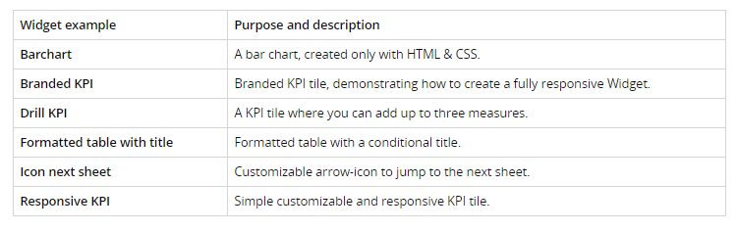
Widgets Examples
Widget examples
The following widgets are included in the widget-examples library that comes with the Qlik Sense installation.

Slide 36
Thank You

